Slide 1

Exploration of possible structure-based models of the mechanism of action of AAA+ ATPases
Master’s project defense - Antoine Maier
Supervisor: Prof. Paolo De Los Rios
External expert: Prof. Francesco Piazza

Slide 2
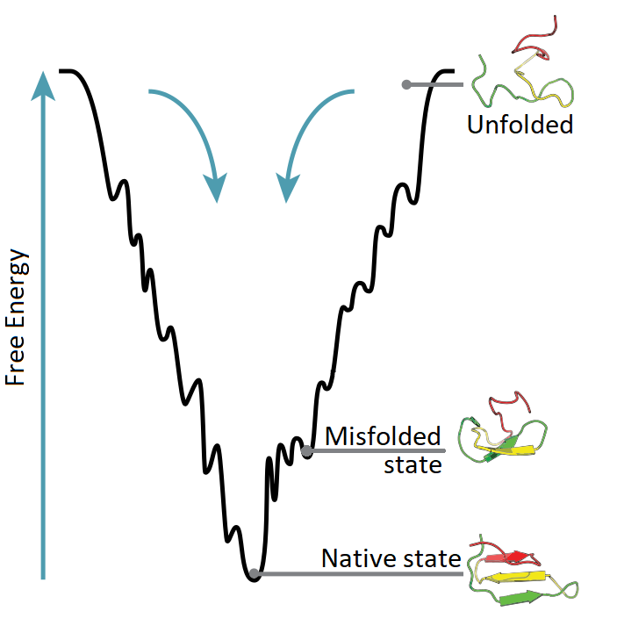
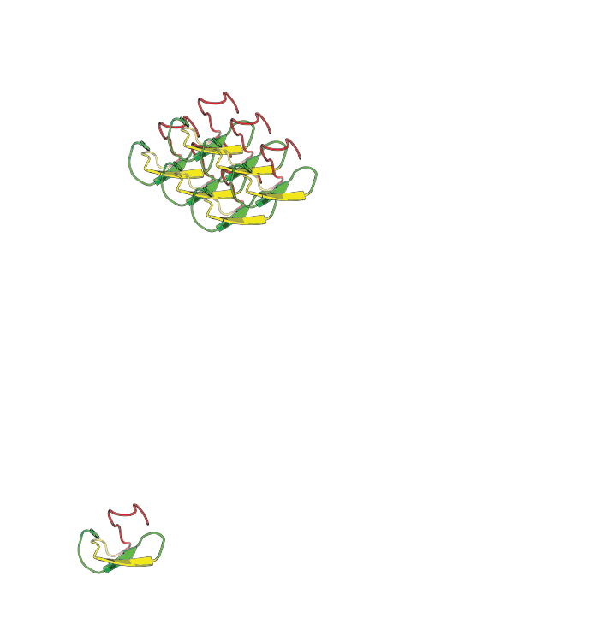


Protein (mis)folding
Correlated
Aggregate
Protein misfolding diseases:
Alzheimer’s disease
Parkinson’s disease
...
By Thomas Splettstoesser (www.scistyle.com) - Own work, CC BY-SA 3.0, https://commons.wikimedia.org/w/index.php?curid=28353539
Adapted by Antoine Maier

Slide 3
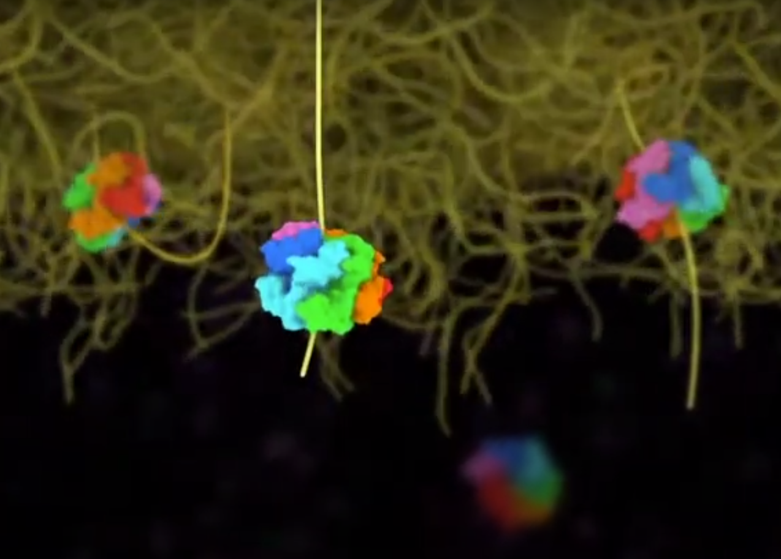
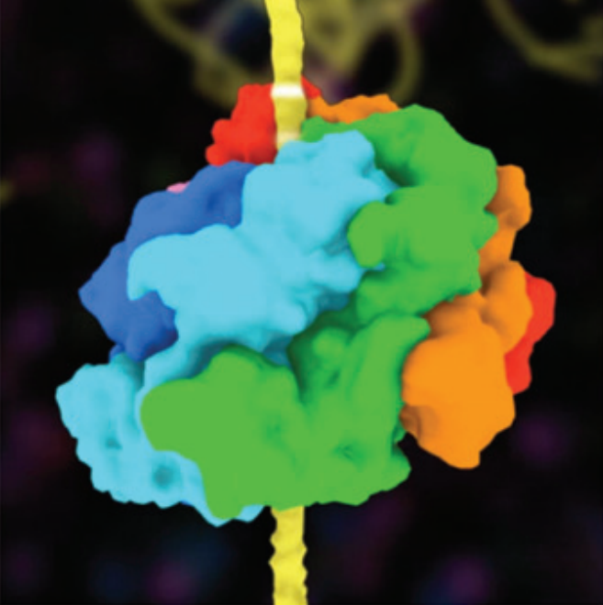
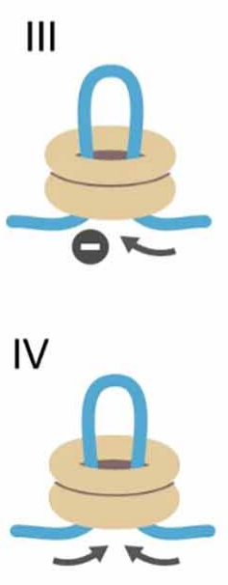
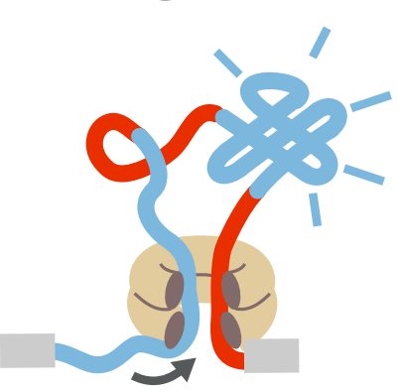
Chaperones Hsp100
AAA+ ATPase, Hsp100 family
Hsp104
ClpB
From animation related to "Ratchet-like polypeptide translocation mechanism of the AAA+ disaggregase Hsp104," Science, June 15, 2017. DOI: 10.1126/science.aan1052
URL: https://www.youtube.com/watch?v=VXupZku6IEg
AVELLANEDA, Mario J. et al. Processive extrusion of
polypeptide loops by a Hsp100 disaggregase.
Nature. 2020, vol. 578, no. 7794, pp. 317–320.
DOI: 10.1038/s41586-020-1964-y.

Slide 4




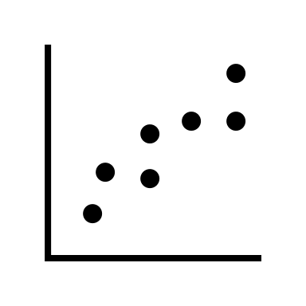

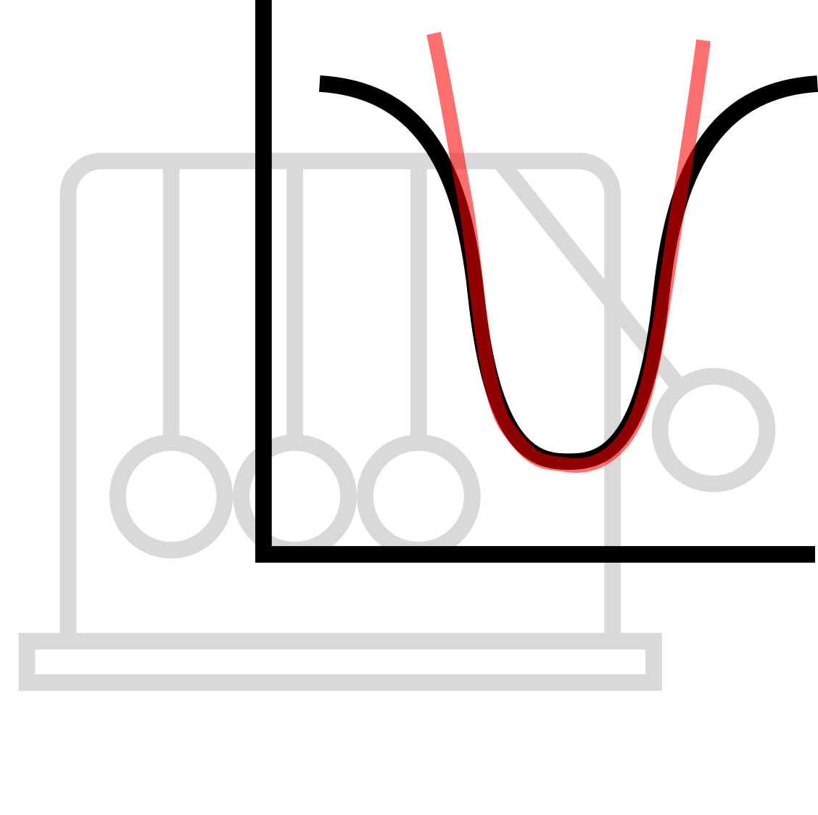


Introducing the method
A
C
B

Slide 5
Theory

Slide 6
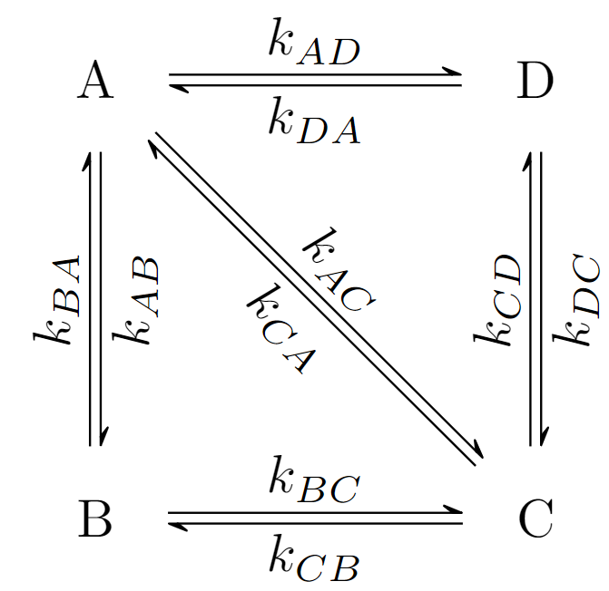


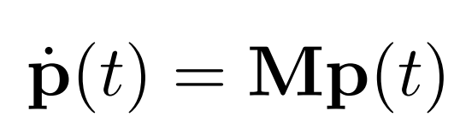
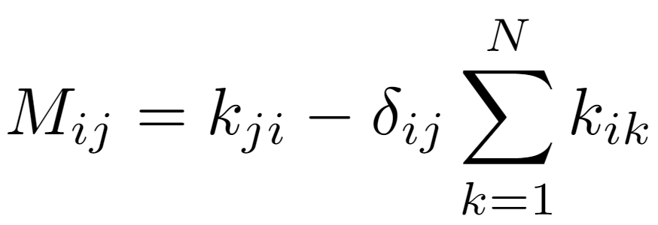
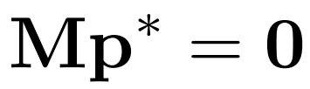
Kinetic scheme
Continuous time Markov chain
Master equation
Steady-state solution

Slide 7
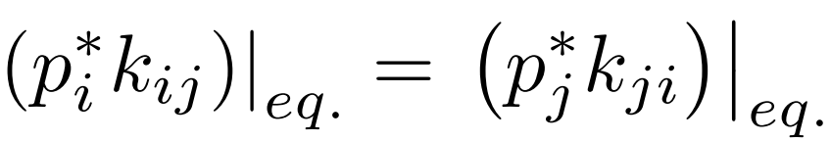

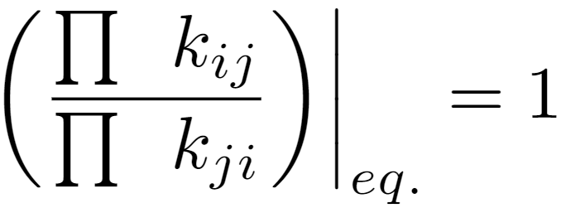
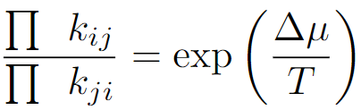
Thermodynamic loop law
At equilibrium:
Detailed balance
=> Thermodynamic loop law:
Out of equilibrium:

Slide 8
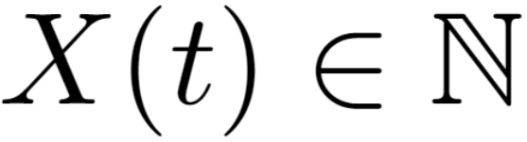
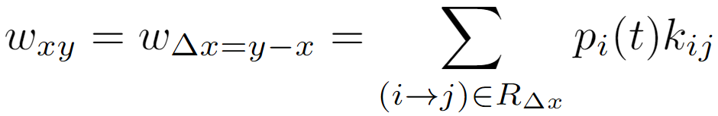
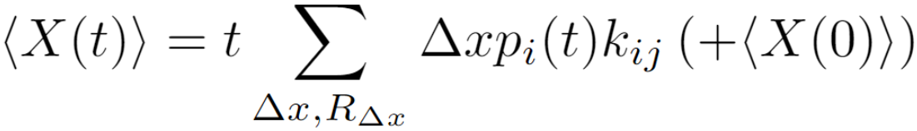
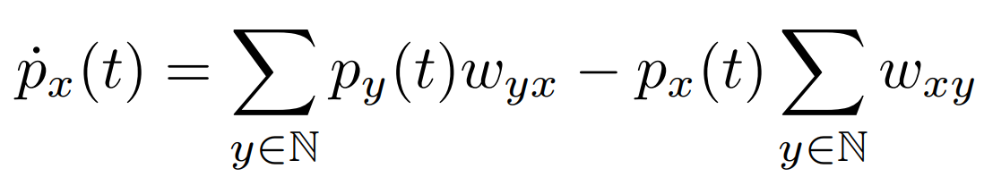
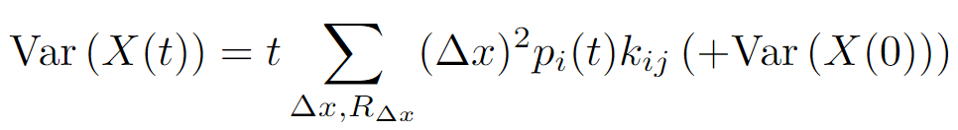
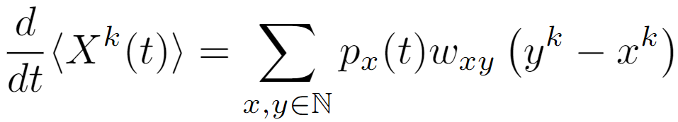
Computing statistics
Using
Master equation
Moments differential equations
(+ characteristic function)

Slide 9
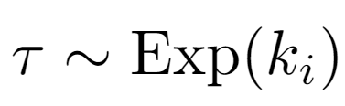
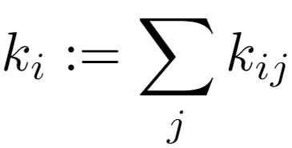
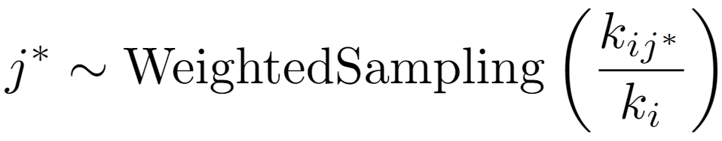
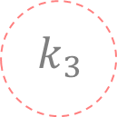
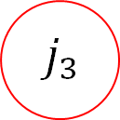
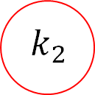
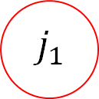
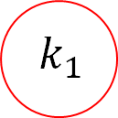

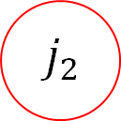
Gillespie algorithm
i
$$j_{4}$$
$$j_{1}$$
$$j_{3}$$
$$j_{2}$$
$$k_{1}$$
$$k_{3}$$
$$k_{2}$$

Slide 10
Translocation models

Slide 11


Coarse-grained modeling
ATP- or ADP-bound
ATP hydrolysis
Protomer(s) translocation
ADP→ATP
exchange
etc
ATP
ADP
ADP
ATP

Slide 12
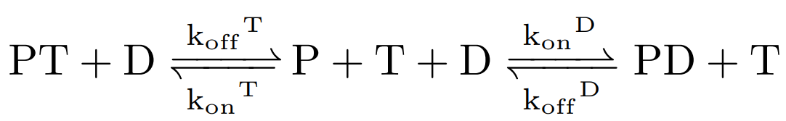
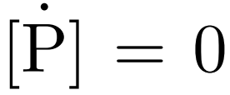
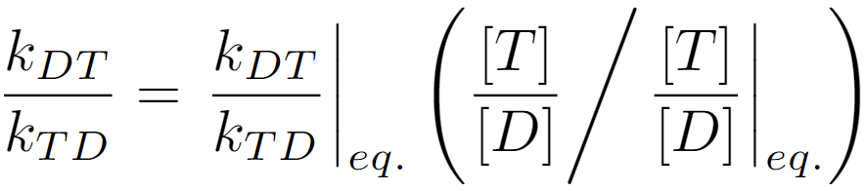
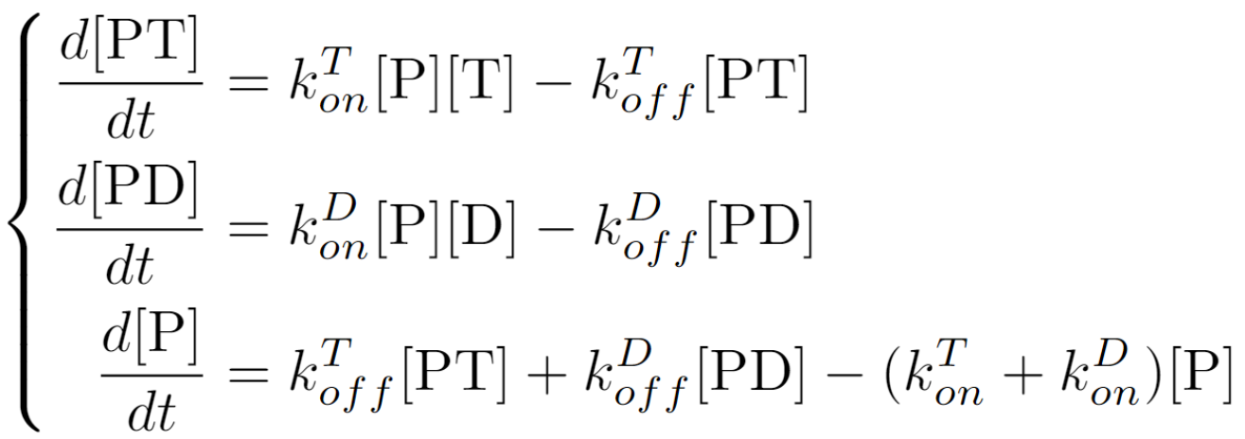
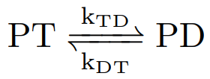
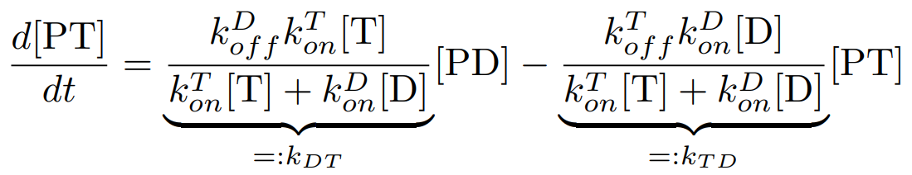
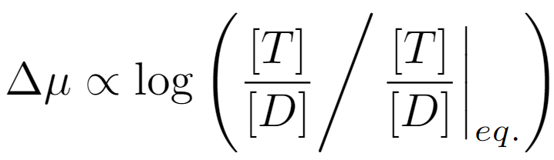
Nucleotide exchange
ATP [T]
ADP [D]
Protein [P]

Slide 13
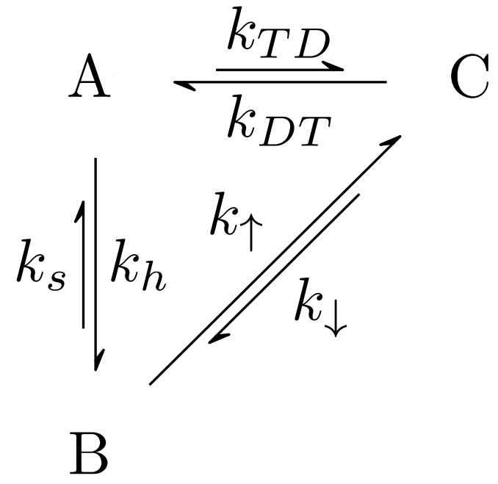

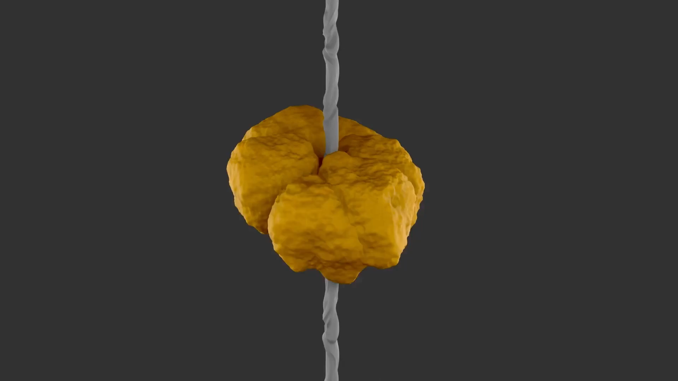
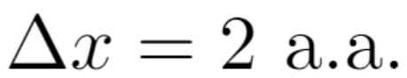
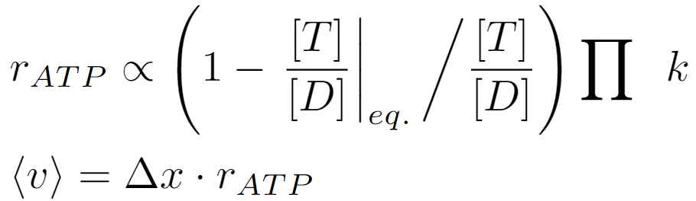
Sequential Clockwise/2-Step Residue (SC/2R)
Spiraling in Control: Structures and Mechanisms of the Hsp104 Disaggregase

Slide 14

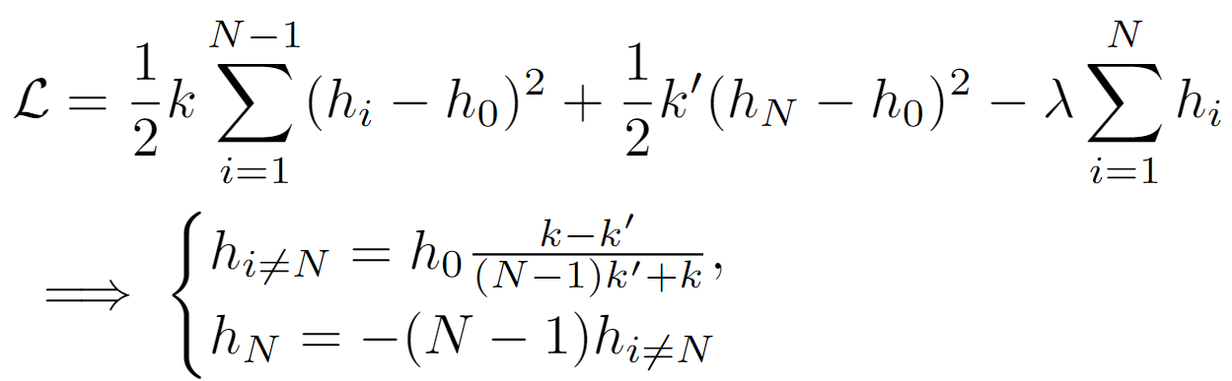
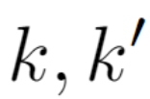
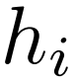
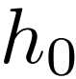
Random Protomer Concertina Locomotion (RPCL)
Hsp104 form[s] a closed hexameric ring.
[...] the cryo-EM is at a lower resolution in this region, indicating conformational flexibility
[...] we identified an additional [...] conformation of Hsp104 in which all six subunits are [...] in an evenly spaced helical spiral
SHORTER, James; SOUTHWORTH, Daniel R.
Spiraling in Control: Structures and Mechanisms of the Hsp104 Disaggregase.
Cold Spring Harbor Perspectives in Biology. 2019, vol. 11, no. 8, a034033.
DOI: 10.1101/cshperspect.a034033.

Slide 15
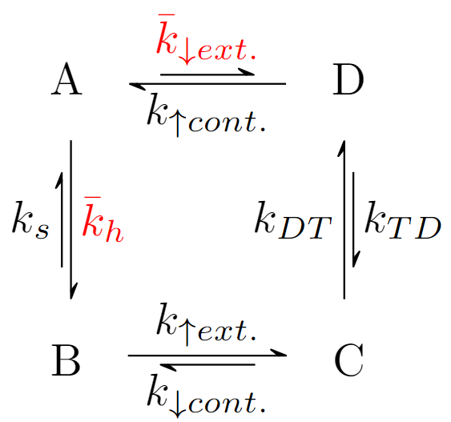
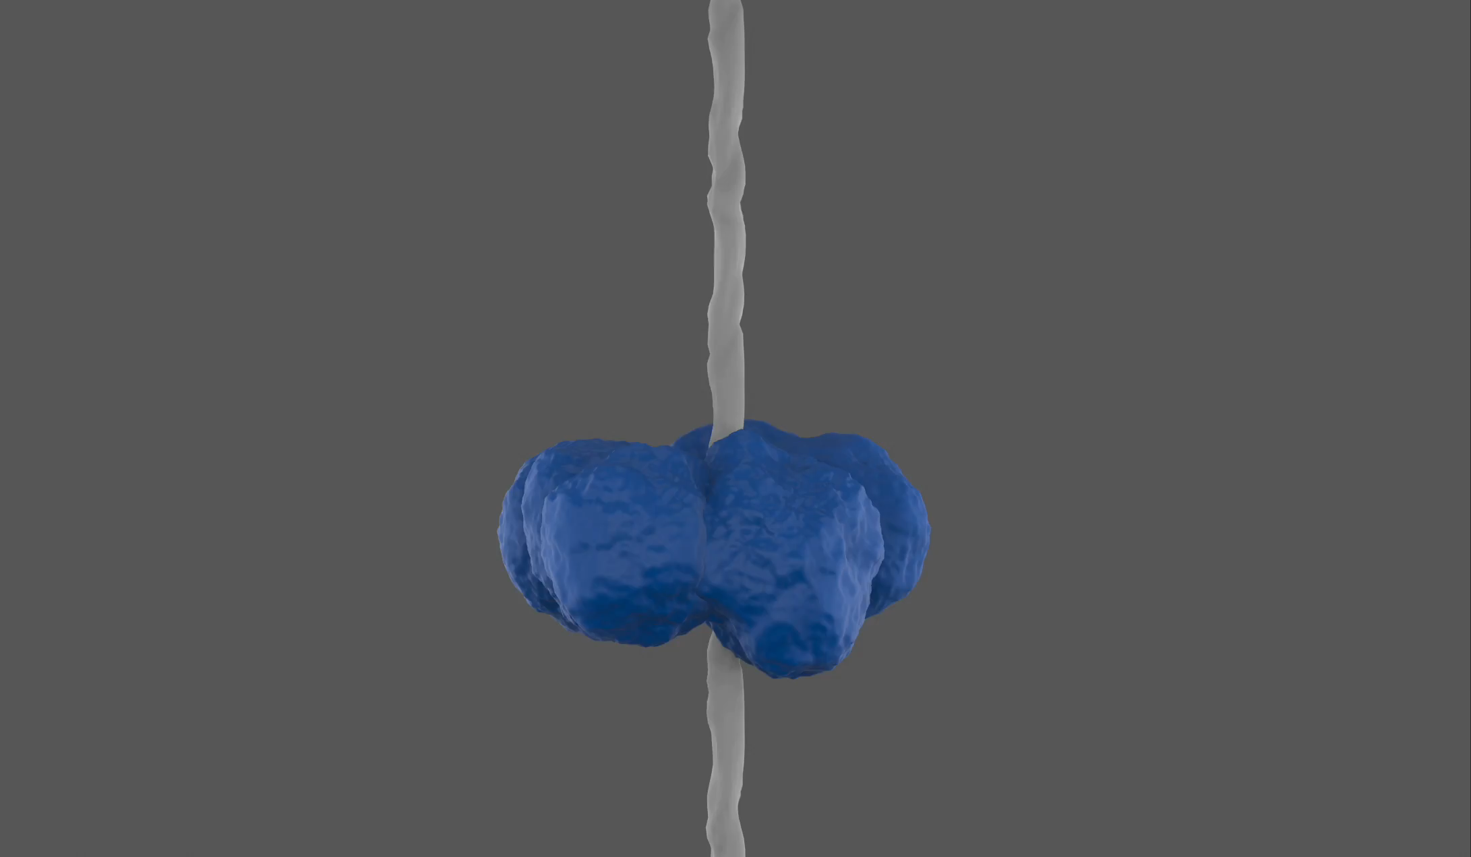
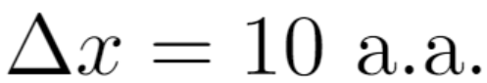
Random Protomer Concertina Locomotion (RPCL)

Slide 16
Numerical experiments

Slide 17
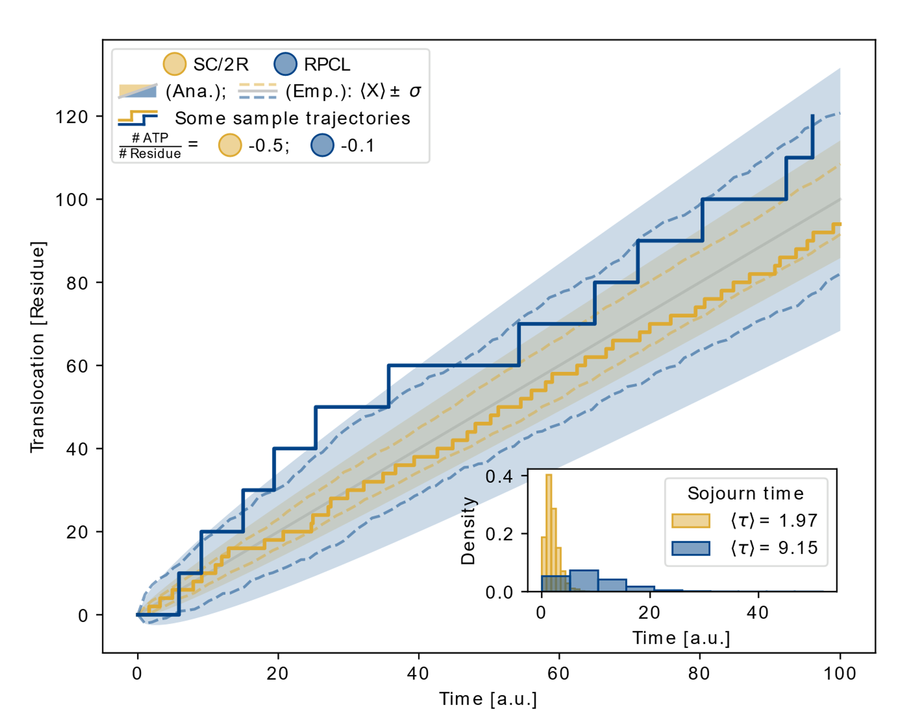
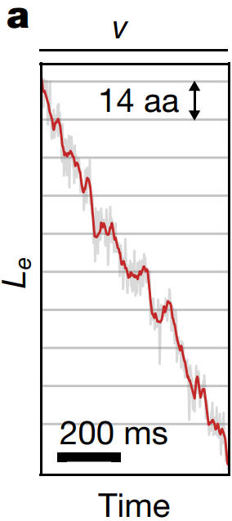
Comparing dynamics
AVELLANEDA, Mario J. et al. Processive extrusion of polypeptide loops by a Hsp100 disaggregase.
Nature. 2020, vol. 578, no. 7794, pp. 317–320. Available from doi: 10.1038/s41586-020-1964-y.

Slide 18



Pulling on the substrate
AVELLANEDA, Mario J. et al. Processive extrusion of polypeptide loops by a Hsp100 disaggregase.
Nature. 2020, vol. 578, no. 7794, pp. 317–320.
DOI: 10.1038/s41586-020-1964-y.

Slide 19

Defective protomer
[...] indicating that Hsp104 power stroke can be generated by ATP hydrolysis in a single subunit.
ESANTIS, Morgan E. et al. Operational Plasticity Enables Hsp104 to Disaggregate Diverse Amyloid and Nonamyloid Clients.
Cell. 2012, vol. 151, no. 4, pp. 778– 793.
DOI: 10.1016/ j.cell.2012.09.038.

Slide 20
Conclusion

Slide 21
SC/2R vs RPCL
 | SC/2R | RPCL
Compatible with cryo-EM observed contracted and extended configurations | Yes | Yes
Predicts contracted and extended configurations | No | Yes
Large translocation steplength | No | Yes
ATP-efficient | No | Yes
Resiliant against defective protomer | No | Yes

Slide 22
Thank you for your attention!

Slide 23

Concertina locomotion
knowerzone. Snakes can climb trees. TikTok. 2023-10-18. Available from https://www.tiktok.com/@knowerzone/video/7291299264095931681

Slide 24


Relation between $\left\langle v\right\rangle$ and $\frac{[ATP]}{[ADP]}$

Slide 25

Translocated length: Error between empirical and analytical standard deviations

Slide 26






Saturating velocities for large forces
SC/2R

